Slide 1
Vibhaag Web App
A college analytics, session monitoring and
management tool
By,
Sudhanva N
PES1201702260
Karthik D
PES1201702449
Harsha K Y
PES1201801839
Guide:
Dr Veena S,
Chairperson,
Department of Computer
Applications

Slide 2
Abstract
The application consists of two components
The web application which helps monitor and manage the activities of the college
The mobile application for end users that acts as a companion and authentication tool
It records the time, date and location of the incident by a QR Code and sends the data securely to the web application

Slide 3
Literature Survey
There are many number of applications which are both free and proprietary. The process of building this application had references to the following applications.
Replicon - is a configurable time and attendance platform enables your organization to manage dispersed workforce.
Jibble - Manage time & attendance for team. Employees can clock in, punch in or as we say, jibble in and out using the iPad Kiosk, Web or Mobile (iOS & Android).
TrackerPal - Time and Attendance Software with Geofencing. Easily manage remote and field employee attendance. Employees punch in and out using their mobile phone.
TimeCamp - In its mobile version, TimeCamp helps users to track time automatically to specific projects, whether new or existing ones, and change the time entries manually.

Slide 4
Introduction
Custom time table for every batch and for every session
Faculties can confirm the class conduction using mobile apps with timings
Meaningful insights such as daily and weekly abstracts can be generated
Admins have the ability to change the time table and re-allocate faculties as per requirement

Slide 5
Tools and Technologies
Core
Deployment
Backend:
Node.js v10.x, Express.js v8.x
Frontend:
React.js v16.x, Redux v16.x
Database:
MongoDB v4.x
Testing:
Mocha, Postman
DevOps:
Github, Travis CI, AWS, Heroku
Other Tools:
Draw.io, Balsamiq

Slide 6
Functional Requirements
User authorization and authentication with role management
User should have restricted access, permission based creation of departments, faculty or any other entity
Customized schedules for sessions for different user or group along with notifications
Create departments, sessions, add faculty, add subjects

Slide 7
Non - Functional Requirements
Performance: Application is build keeping scalability in mind meaning that is can serve lots of users without fail
Availibility: Since it is an online application, it is available at all times as long the user has an active internet connection
Maintainability: Version control with continuous integration and continuous delivery for seamless development operations
Data Integrity: Data is store in multiple nodes as a backup in case of emergenices or recovery

Slide 8
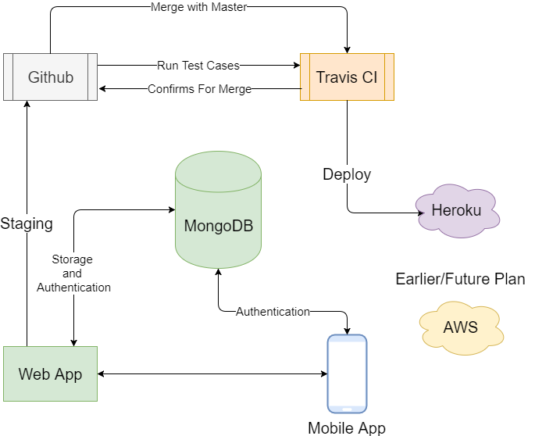
Process Flow

Slide 9
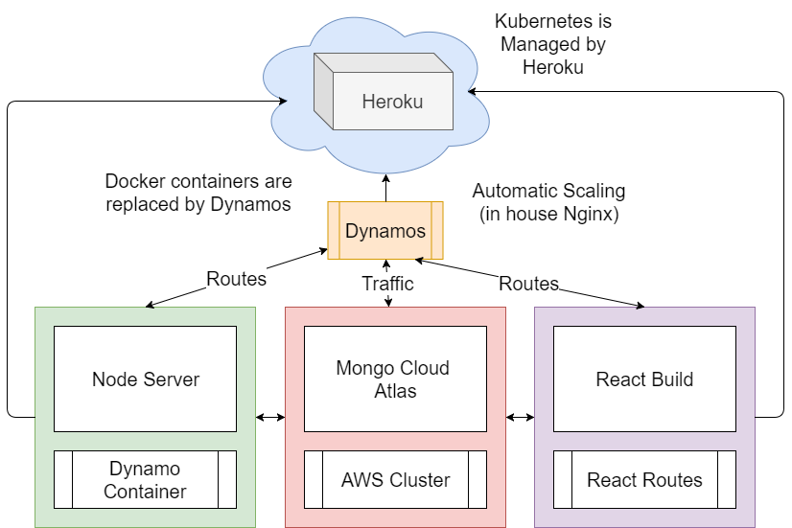
System Design

Slide 10
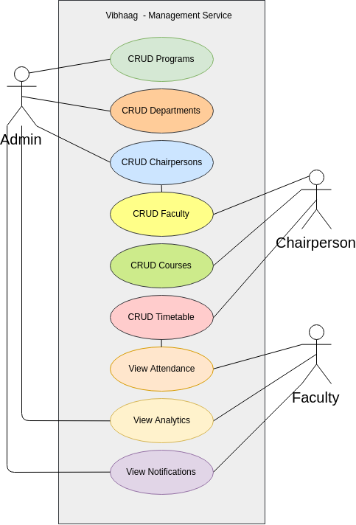
Use Cases

Slide 11
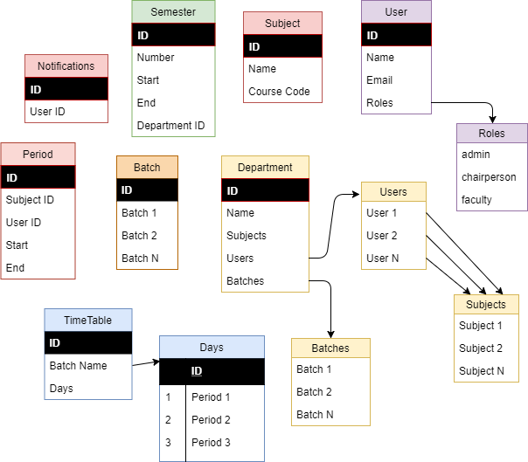
Database
Structure

Slide 12
Test Cases

Slide 13
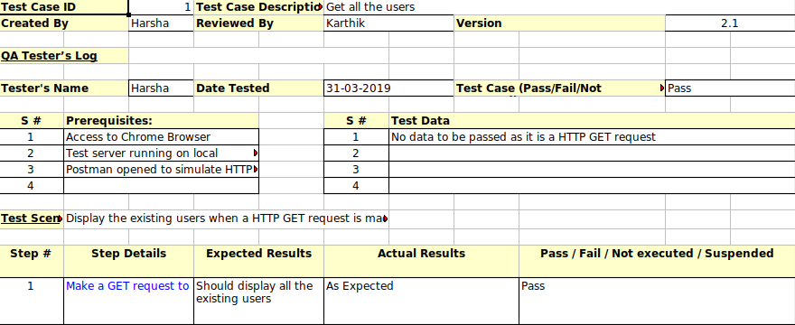

Slide 14
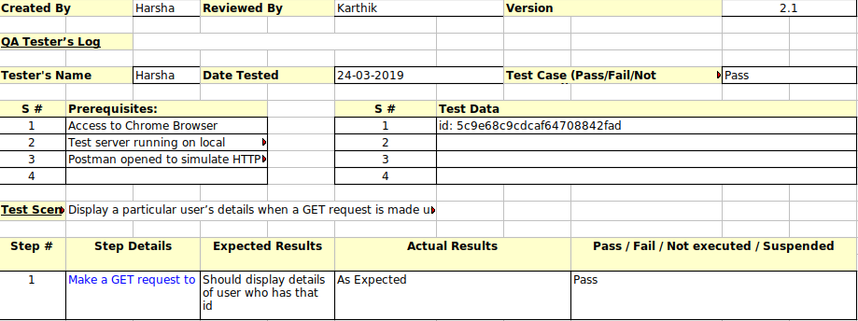

Slide 15
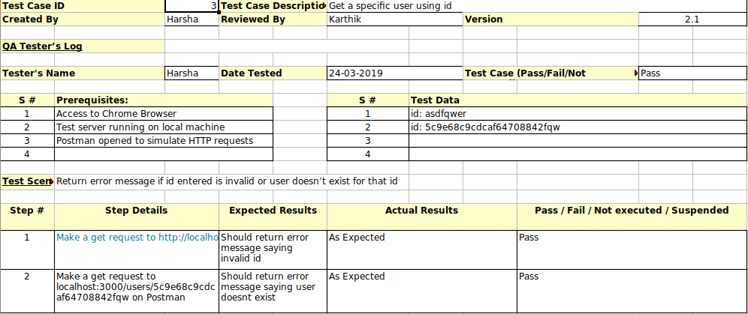

Slide 16
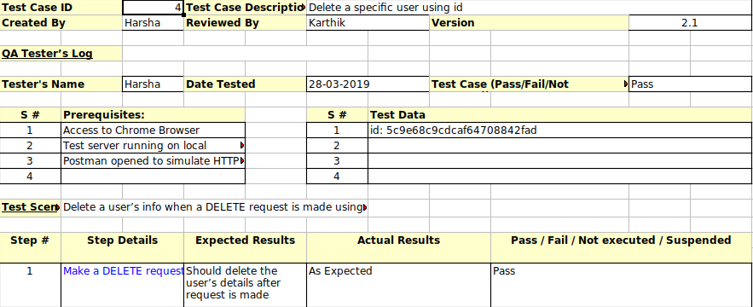

Slide 17
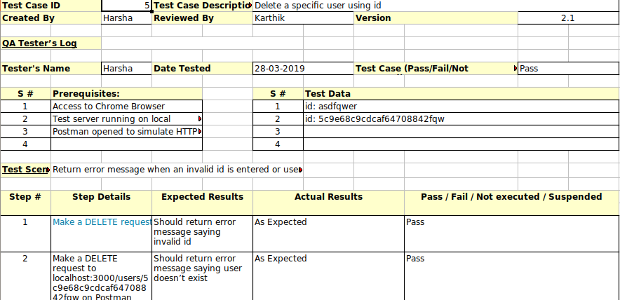

Slide 18
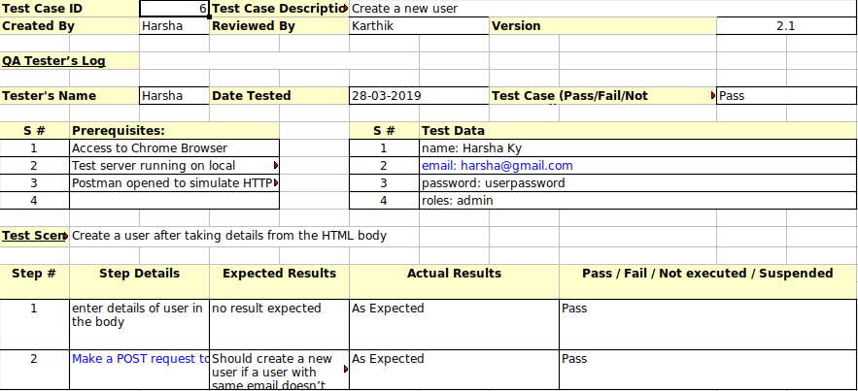

Slide 19
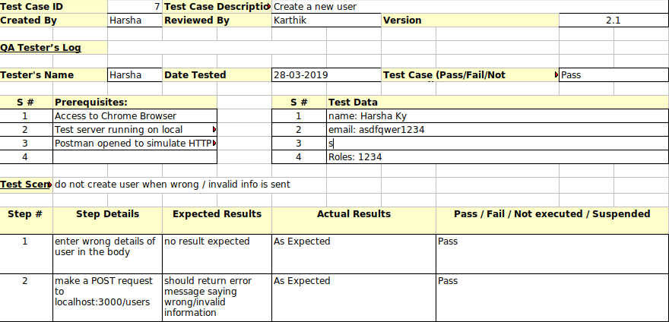

Slide 20
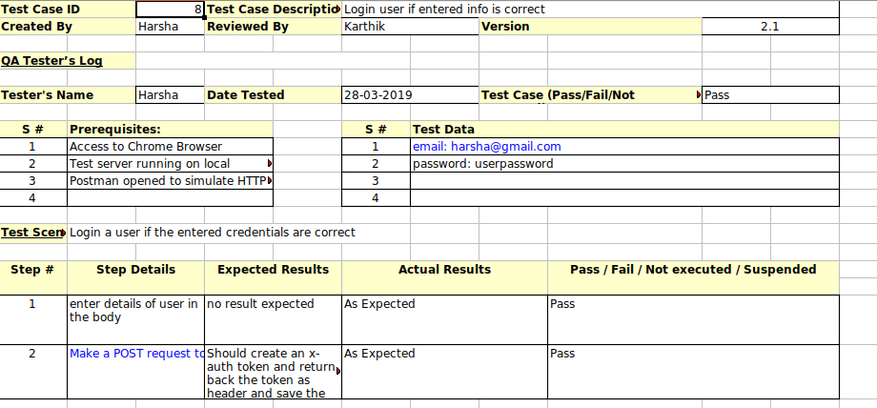

Slide 21
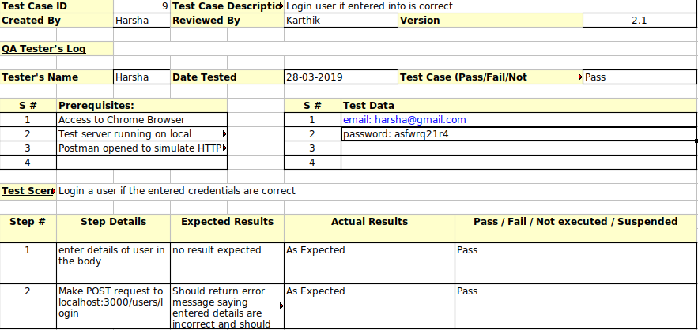

Slide 22
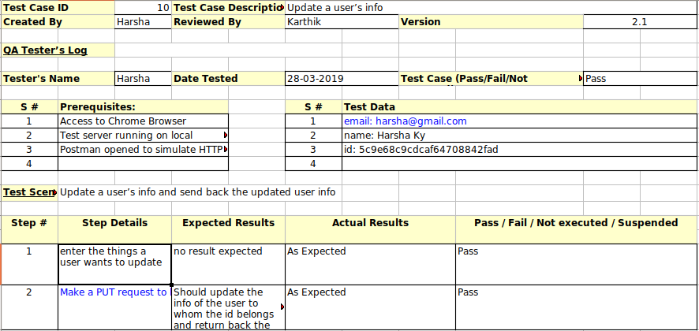

Slide 23
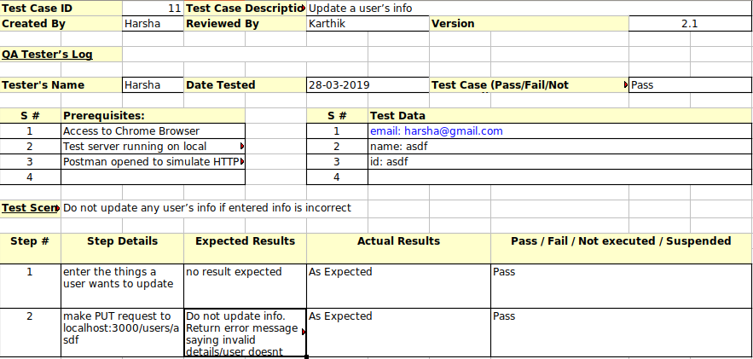

Slide 24
Conclusion
This application tries to solve a real life problem at an affordable cost. It takes the best features of few applications and embeds them in itself.
This application is simple, user friendly and has a formal UI.
The project is currently under the development phase where it is being tested for accuracy and reliability.
It will help every enterprise in making their day to day processes easier and accountable.
Further plan is to deploy the product inany enterprise organization which strive for quality.

Slide 25
Bibiliography
ReactJS documentation: https://reactjs.org/
Redux documentation: https://redux.js.org/
NodeJS documentation: https://nodejs.org/en/
Firebase documentation: https://firebase.google.com
Medium and freecodecamp: https://medium.com

Slide 26
Future Enhancement
Now the application records the actual event based on QR-Code scanner. In future, location based authentication, like co-ordinates of classroom, will be more efficient
The application depends on user’s email and password for account validation. In addition to that device fingerprint authentication can be added.
Implementation of smart time table scheduler, automatic assignment of faculty if there is shortage or emergencies

Slide 27
Demo

